Slide 1
Technology During Mary Shelley's life
By: Kurtis Bowen

Slide 2
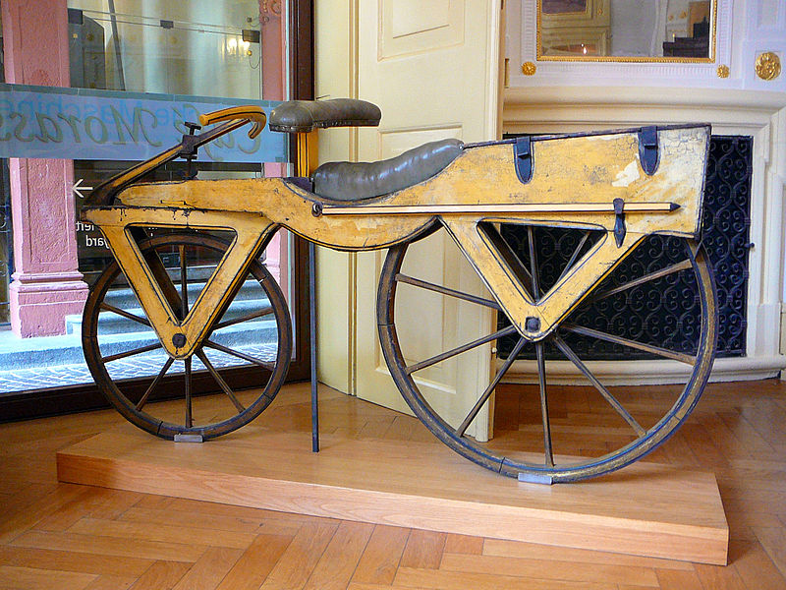
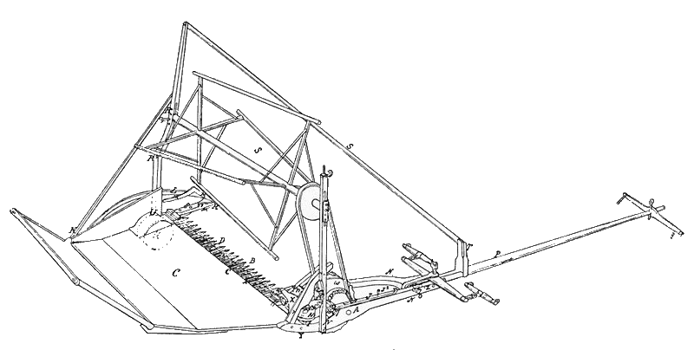
Technological Advances
The Mechanical Reaper
“Draisienne” Bicycle

Slide 3
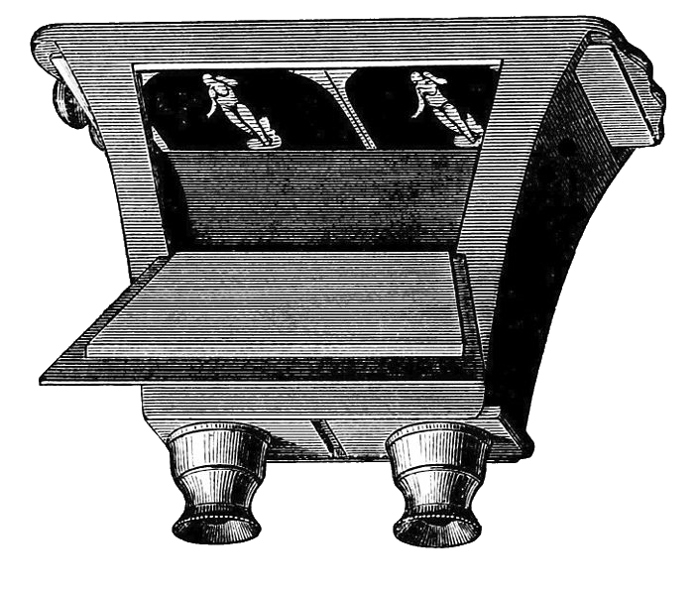
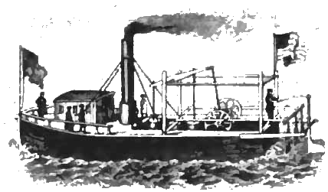
Technological Advances
Improved Steamboats
3-D Stereoscopy

Slide 4
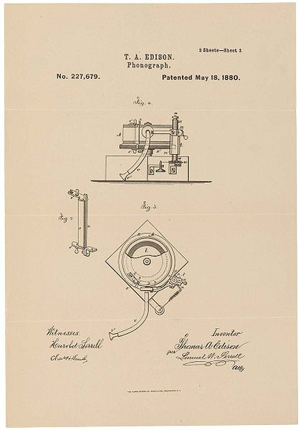
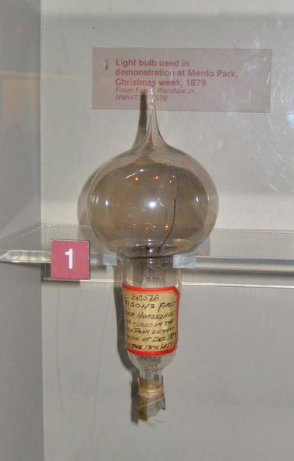
Technology She Missed
Light Bulbs
Phonograph

Slide 5
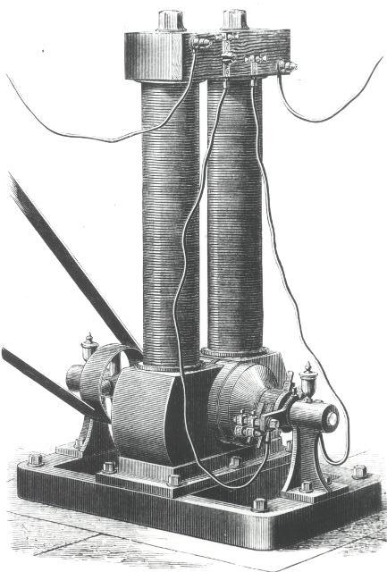
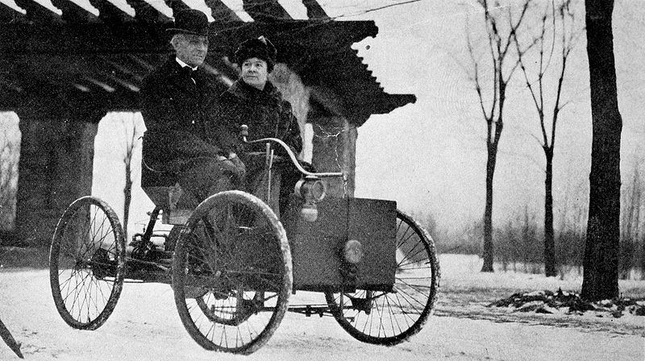
Technology She Missed
Electric Dynamo
Ford’s Cars
© SI ©SIRIS ©Smithsonian

Slide 6
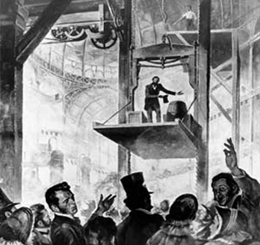
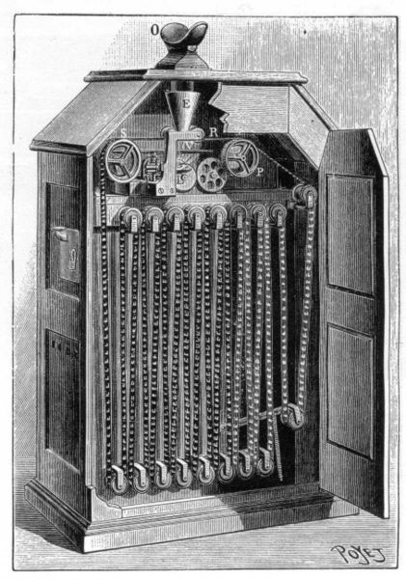
Technology She Missed
Elevators
Movies (Kinetoscope)

Slide 7
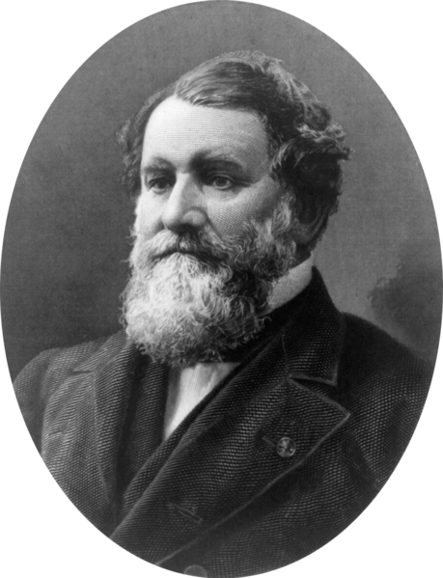
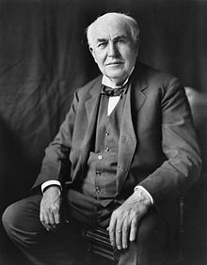

Famous Inventors of Her Time
Cyrus McCormick
Thomas A. Edison

Slide 8
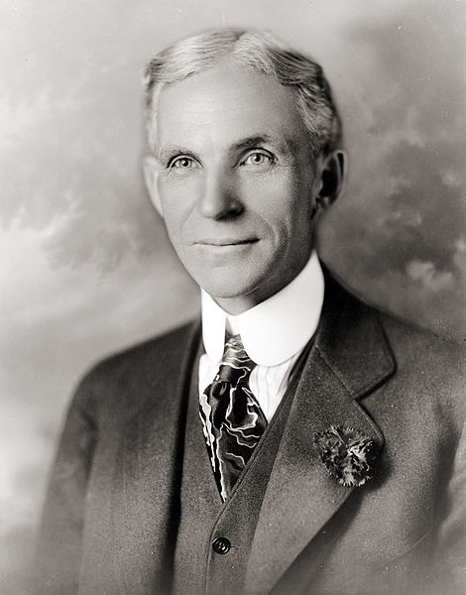

Famous Inventors of Her Time
Henry Ford

Slide 9
Inventions She Would Have Used
The Mechanical Reaper
“Draisienne” Bicycle

Slide 10
Inventions She Would Have Used
Improved Steamboats
3-D Stereoscopy

Slide 11
Image Info
All Images Are from the Public Domain unless noted otherwise

